Slide 1
Welcome to the RWInc Workshop
Brief explanation of what RWInc is and how it works.
Sample session- introducing a sound and blending.
Brief explanation of how you can support your child at home/home reading books.
Look at resources/questions.

Slide 2
What is RWInc?
We use RWInc in Foundation, Year 1 and Year 2 to support children to read and write. The children then follow the RWInc spelling sessions across the school.
Your child will learn to read in a very simple way. He or she will learn to: 1. Read letters by their ‘sounds.’ See chart. 2. Blend these sounds into words. 3. Read the words in a story.

Slide 3
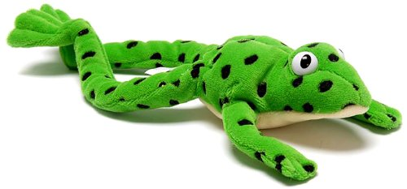
Meet Fred!
Fred can only talk in sounds. We play games with Fred such as ‘Fred Says’ and ‘Little Green Fred had a Farm.’

Slide 4
What do we do in a session?
Whole class- (Modelled by Mrs Watts)
Introduce a new sound.
Look at words that begin/end with the sound.
Review sounds we have learnt so far.
Fred talk words with that sound in them.
Small groups-
Write the sound, make and read words, learn to spell with Fred Fingers.
Use lots of praise and encouragement- Marshmallow claps, Honk horns, Round of a claws, Fireworks, Hip, hip, hooray and lots more!

Slide 5
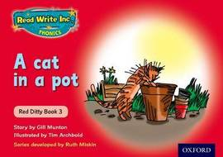
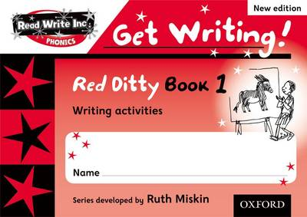
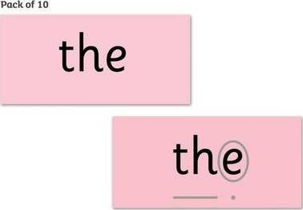
What’s next?
Ditty sheets.
Books and activities.
Red words.

Slide 6
How can I help my child at home?
Share books that you love.
Read the books sent home together and write comments in your child’s Reading Record. We change books on a Monday, Wednesday and Friday.
Play games as suggested with the sounds that we have learnt each week.
Talk, play, enjoy experiences together!

Slide 7
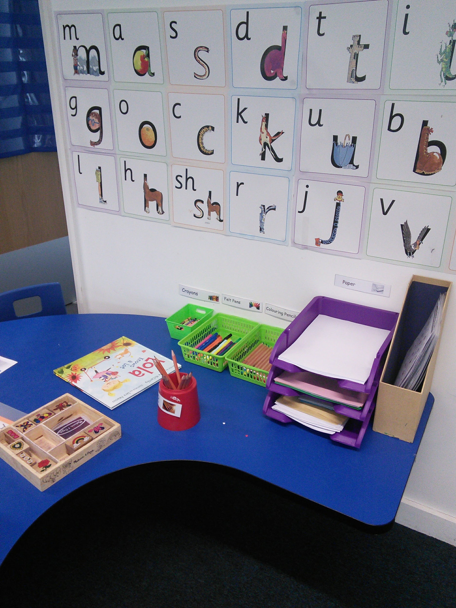
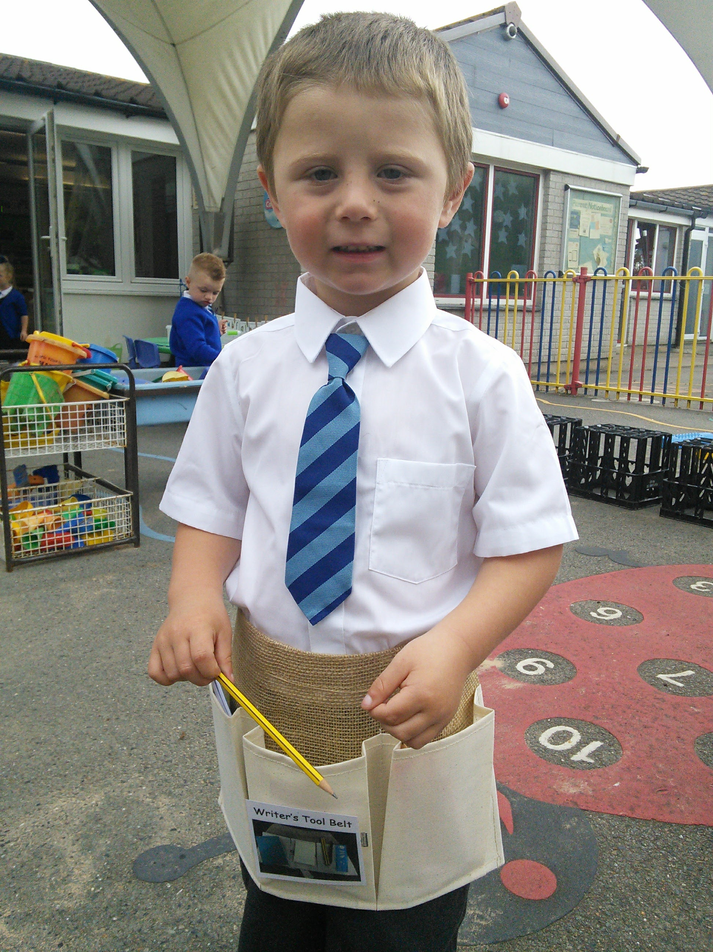
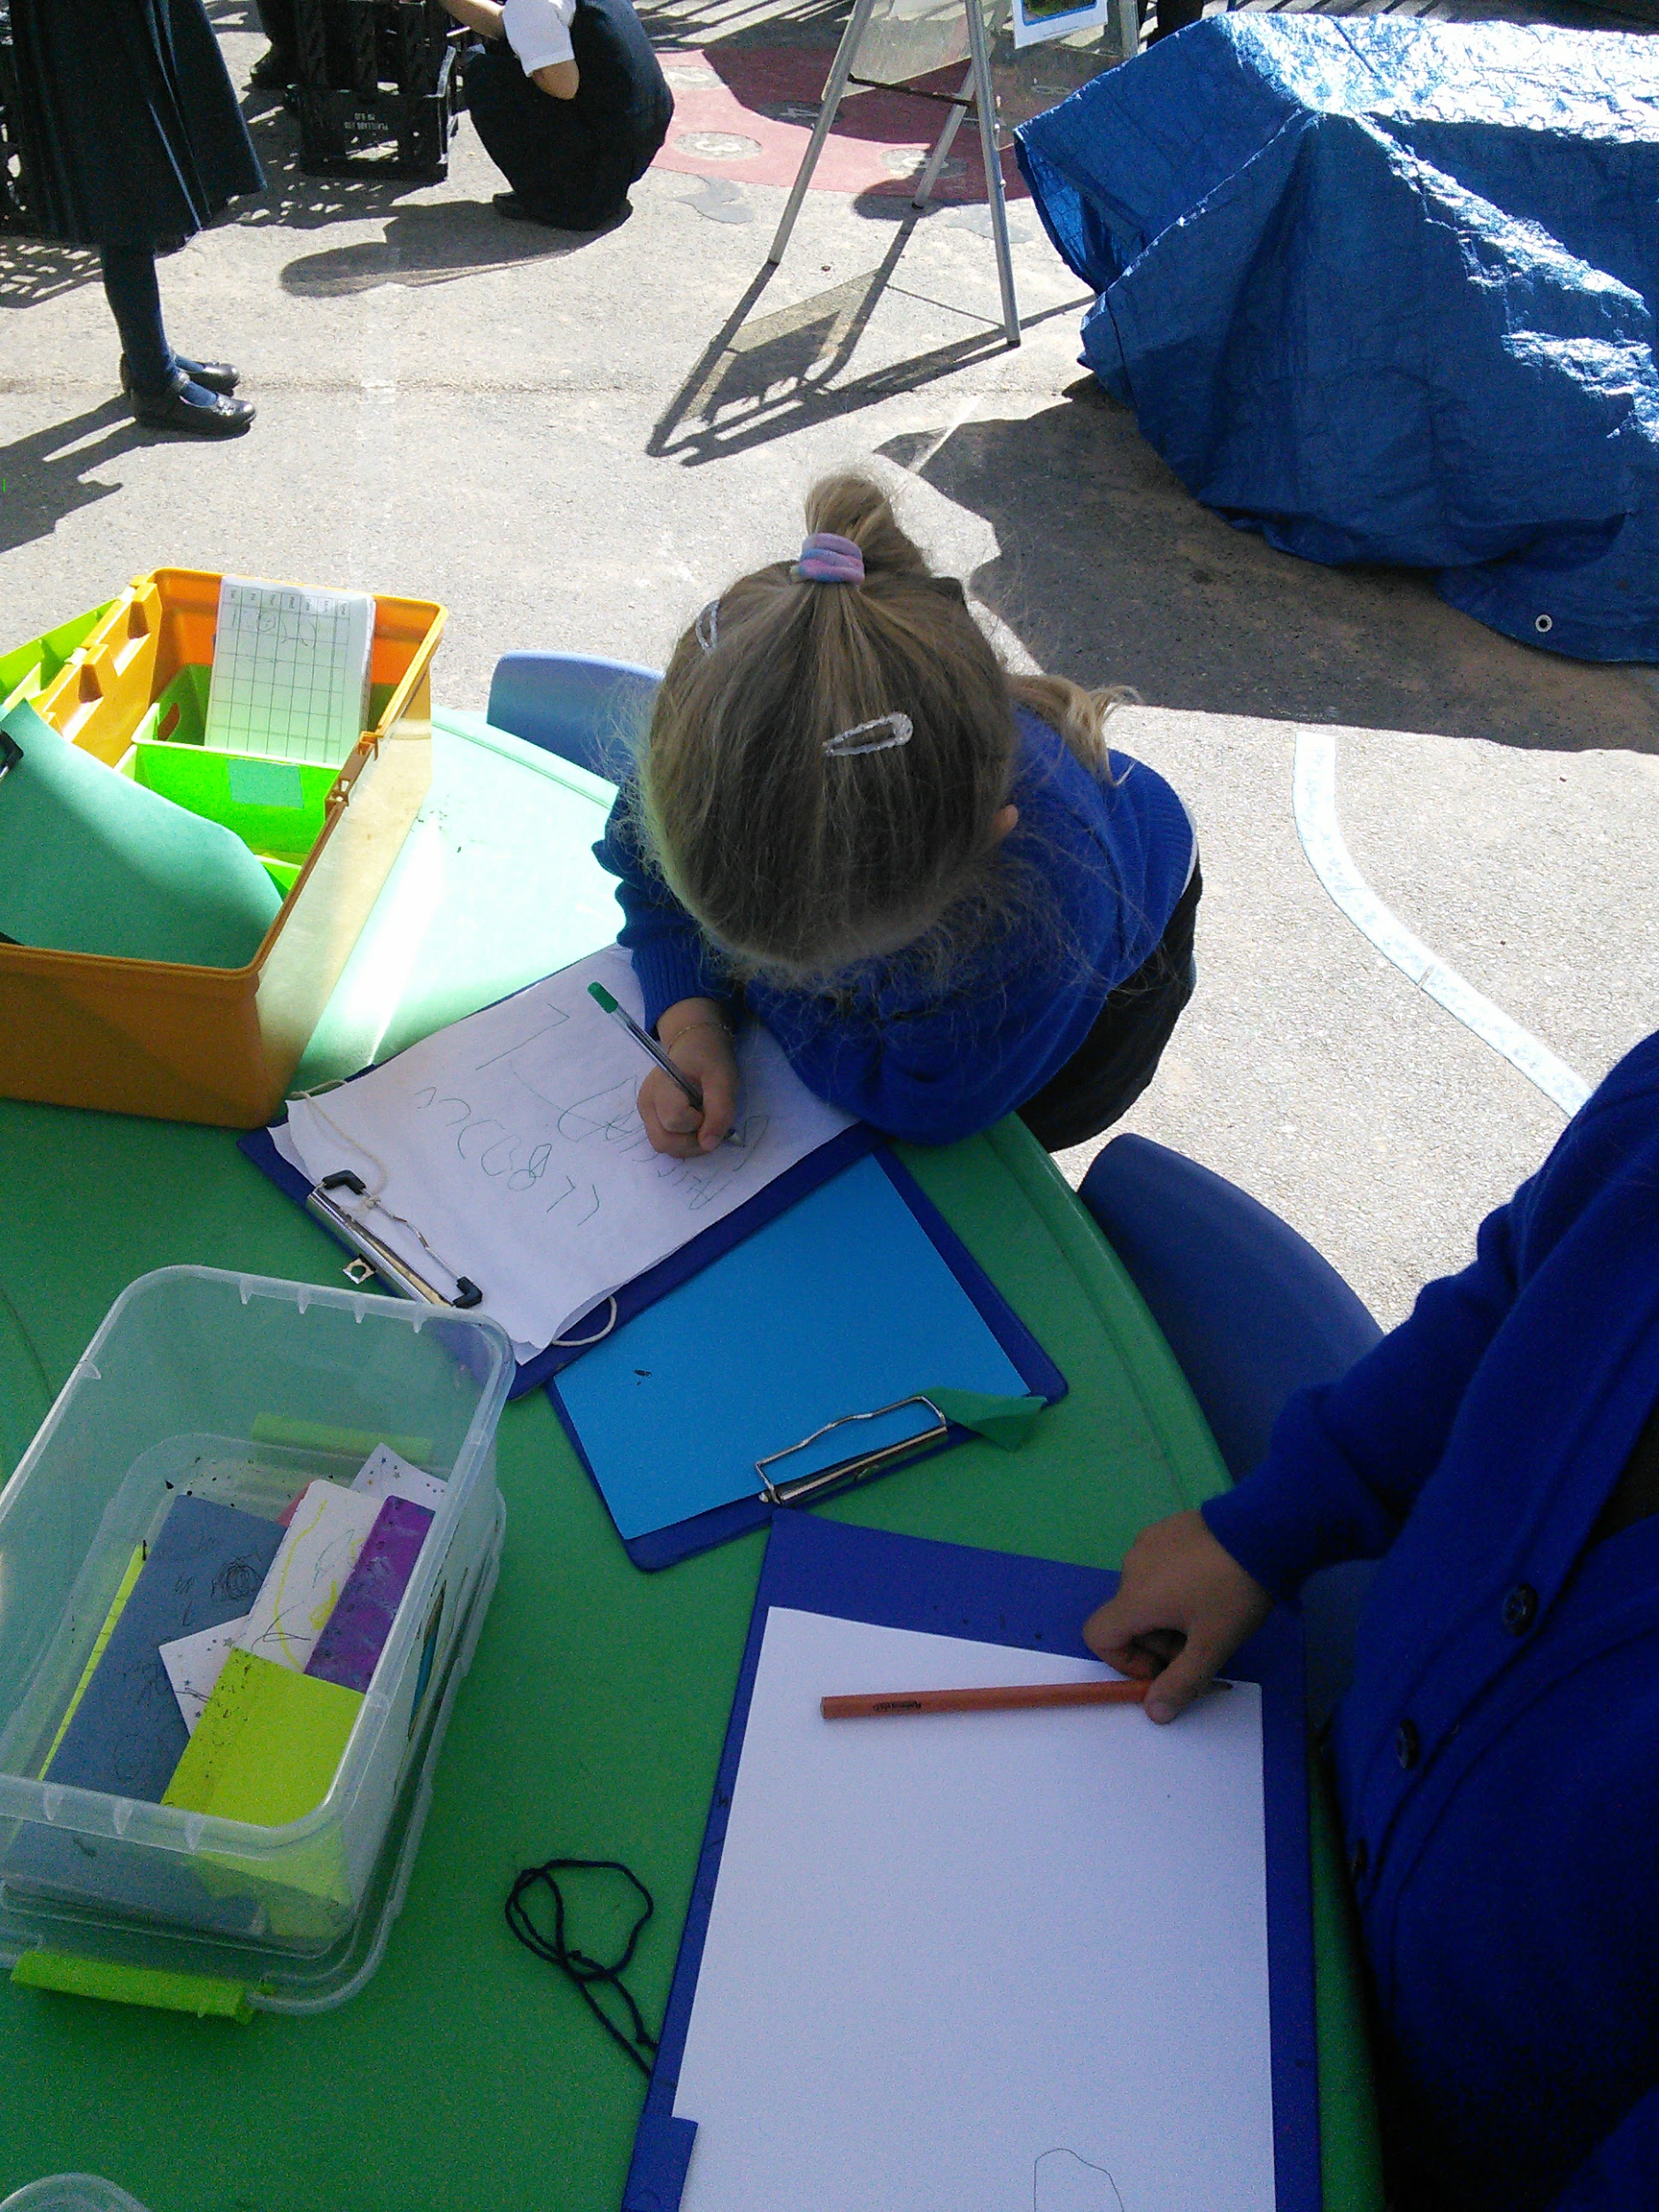
Any Questions?
Have a play with the resources we use!

